Slide 1
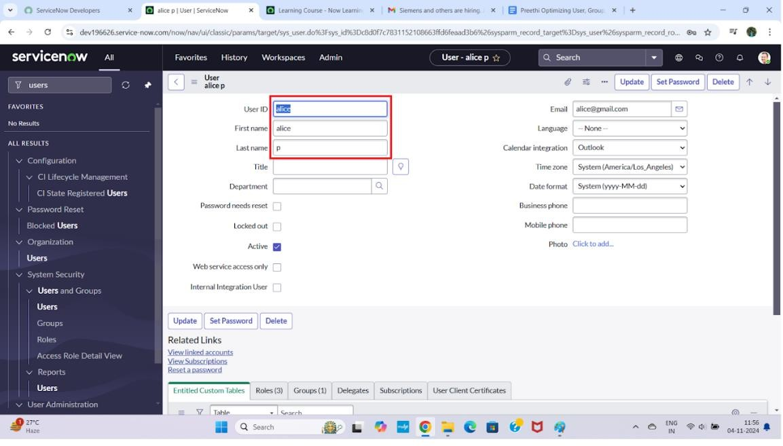
Optimizing User, Group, and Role Management with Access Control and Workflows
Create Users :
Open service now
Click on All >> search for users
Select Users under system security
Click on new
Fill the following details to create a new user
Click on submit
7.
Create one more user:
Create another user with the following details
Click on submit

Slide 2
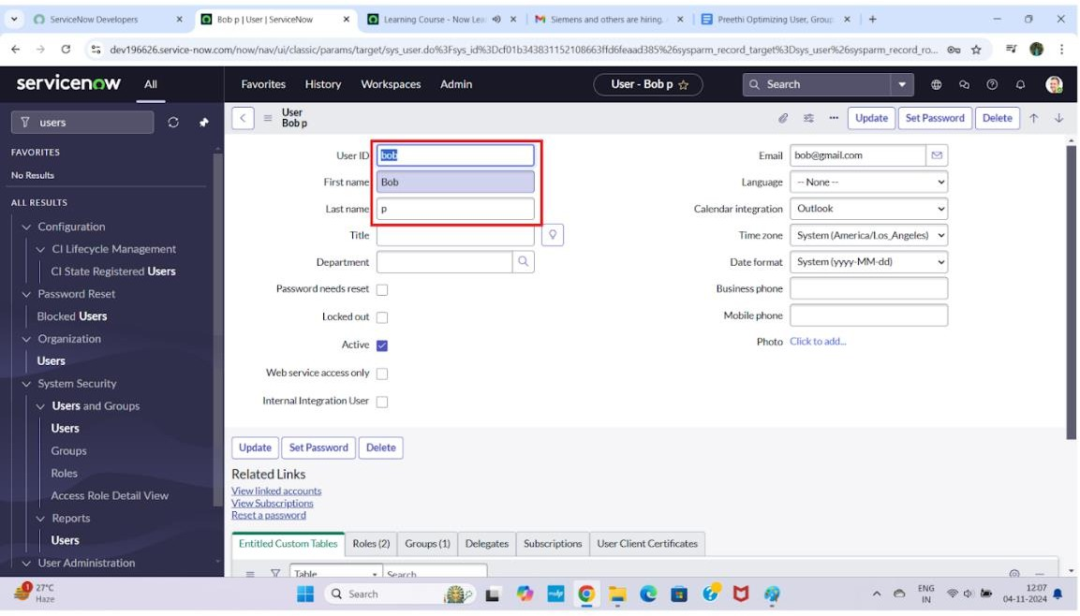
11.
Create Groups :
Open service now.
Click on All >> search for groups
Select groups under system security
Click on new
Fill the following details to create a new group
Click on submit

Slide 3
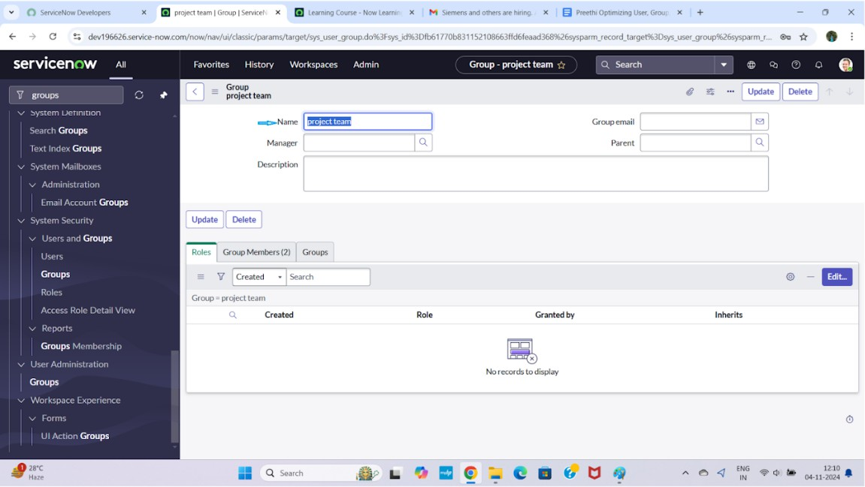
Create Roles :
Open service now.
Click on All >> search for roles
Select roles under system security
Click on new
Fill the following details to create a new role
Click on submit

Slide 4
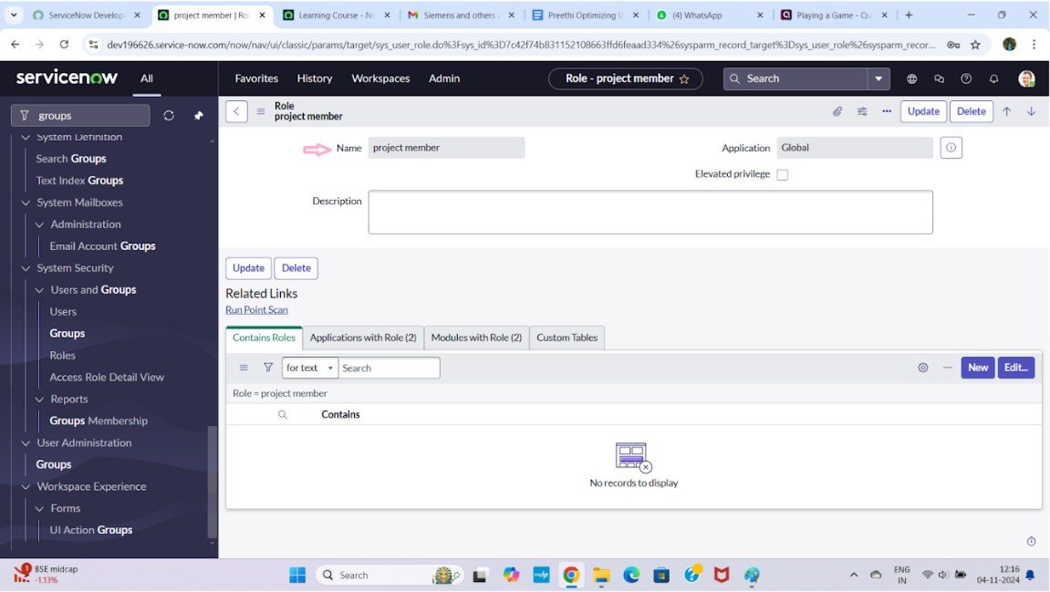
Create one more role:
Create another role with the following details
Click on submit
Create Table :
Open service now.
Click on All >> search for tables
Select tables under system definition
Click on new
Fill the following details to create a new table Label : project table
Check the boxes Create module & Create mobile module
Under new menu name : project table
Under table columns give the columns

Slide 5

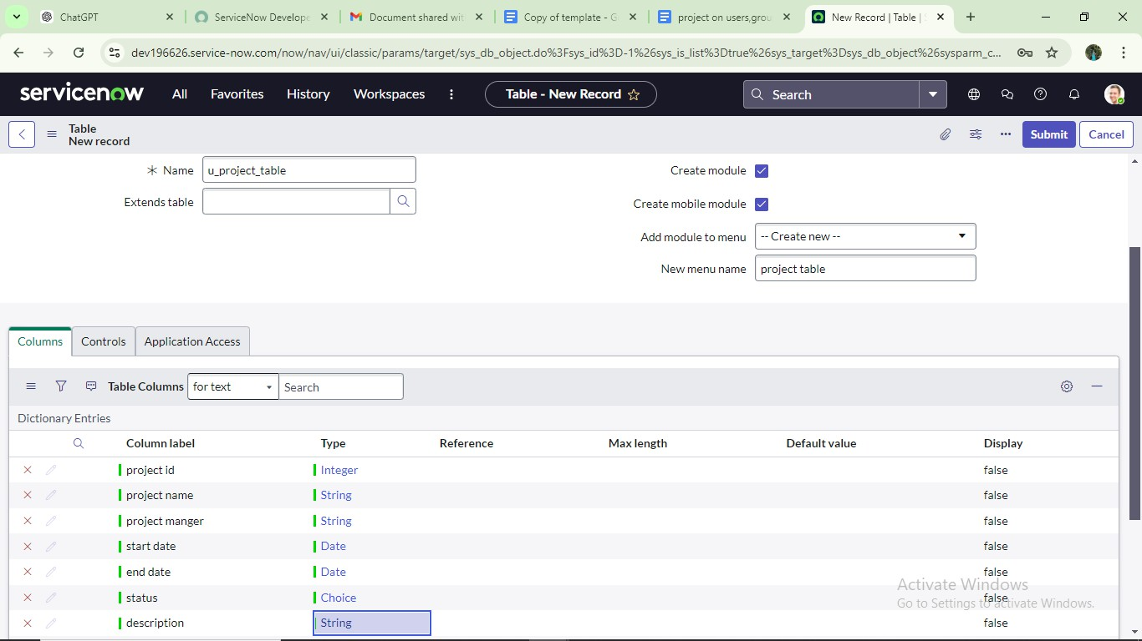
8.
Click on submit
Create one more table:
Create another table as:task table 2 and fill with following details.

Slide 6
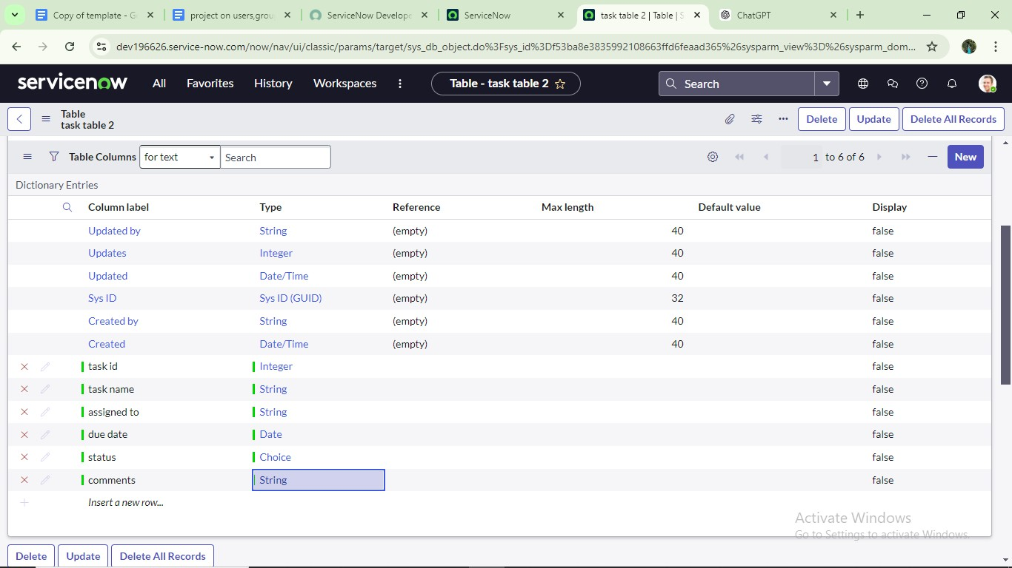
Click on submit.
Assign users to project team group :
Open service now.
Click on All >> search for groups
Select tables under system definition
Select the project team group
Under group members
Click on edit
Select alice p and bob p and save

Slide 7
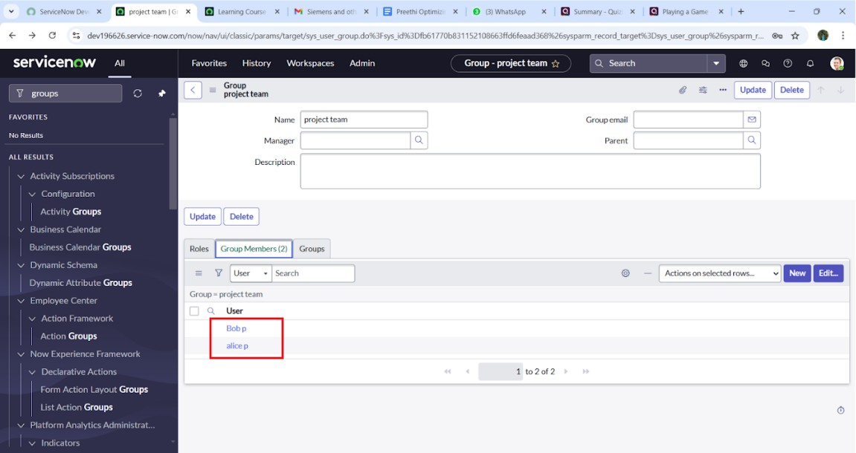
Assign roles to alice user :
Open servicenow.Click on All >> search for user
Select tables under system definition
Select the project manager user
Under project manager
Click on edit
Select project member and save
click on edit add u_project_table role and u_task_table role

Slide 8
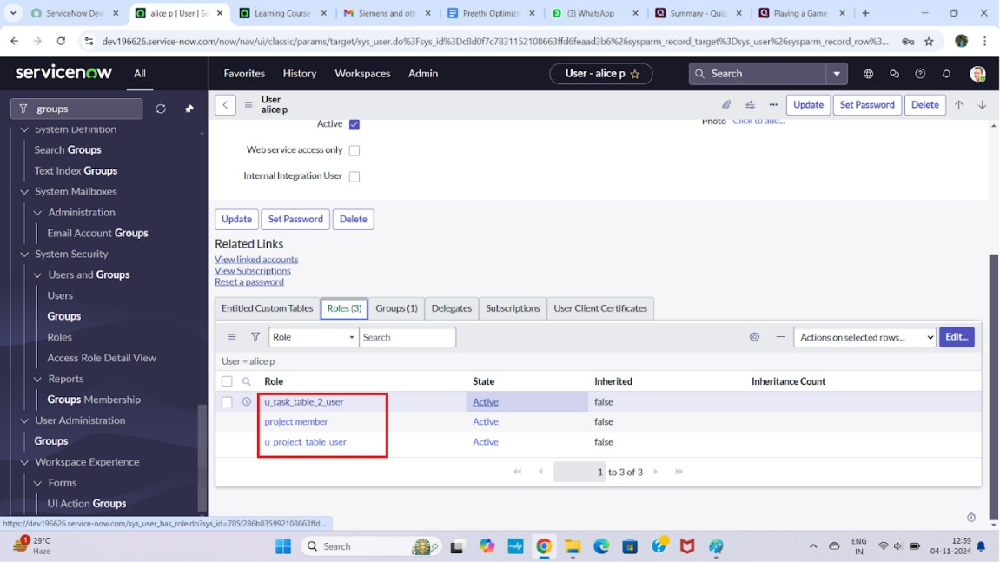
8. click on save and update the form.
Assign roles to bob user :
Open servicenow.Click on All >> search for user
Select tables under system definition
Select the bob p user
Under team member
Click on edit
Select team member and give table role and save
Click on profile icon Impersonate user to bob

Slide 9
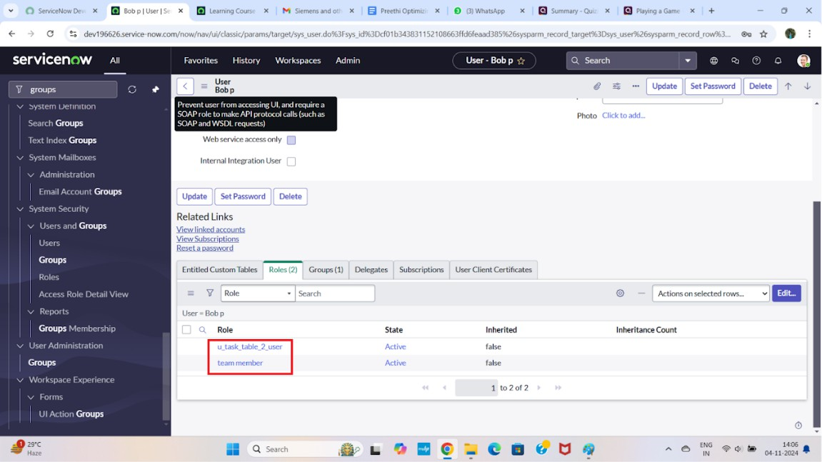
8. We can see the task table2.
Assign table access to application :
while creating a table it automatically create a application and module for that table
Go to application navigator search for search project table application
Click on edit module
Give project member roles to that application
Search for task table2 and click on edit application.
Give the project member and team member role for task table 2 application

Slide 10


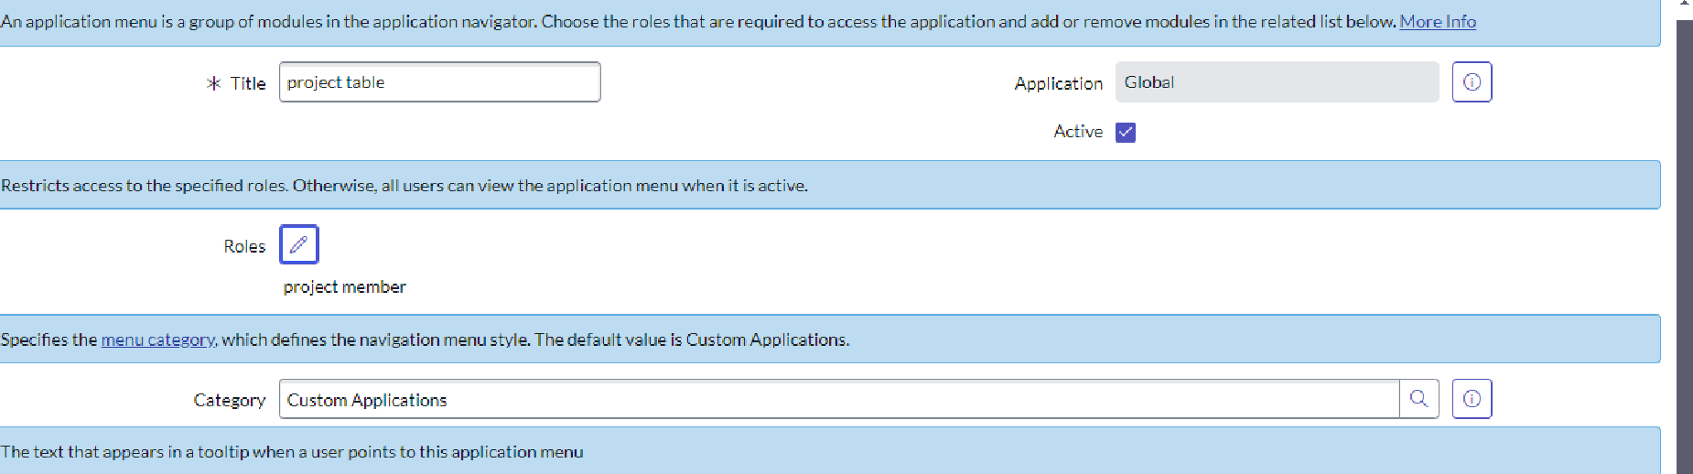
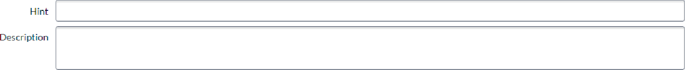
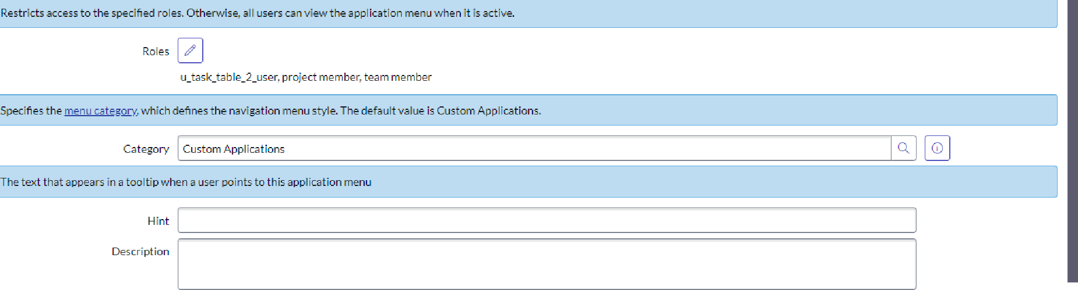
Activate W iiJdov.'s

Slide 11
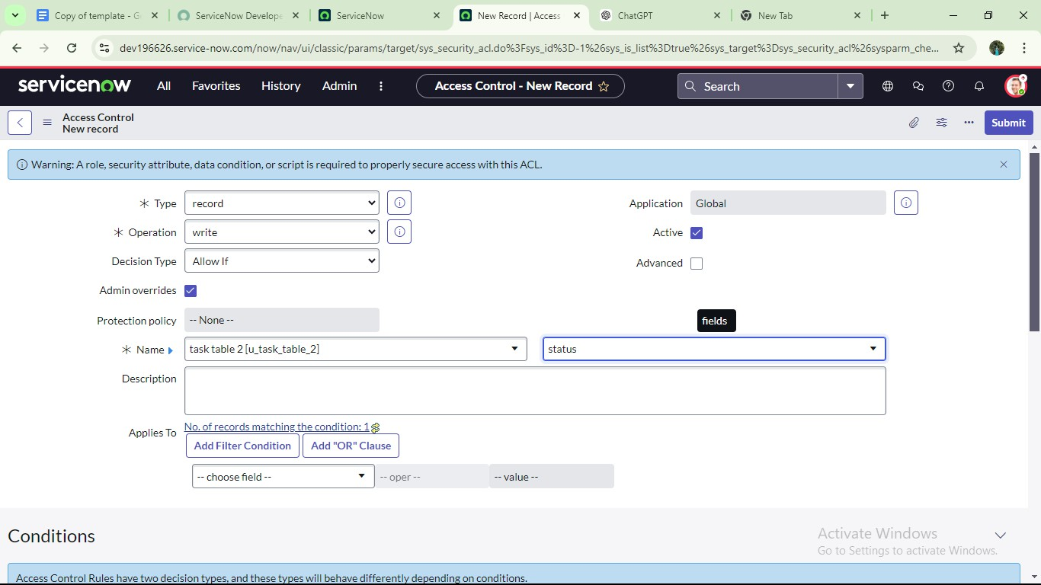
Create ACL :
Open service now.
Click on All >> search for ACL
Select Access Control(ACL) under system security
Click on elevate role
Click on new
Fill the following details to create a new ACL
Scroll down under requires role
Double click on insert a new row
Give task table and team member role
Click on submit

Slide 12
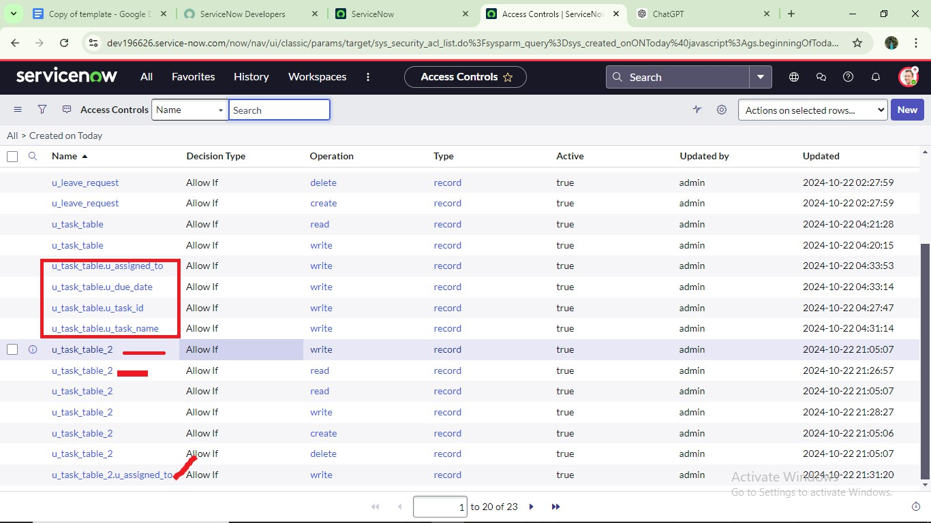
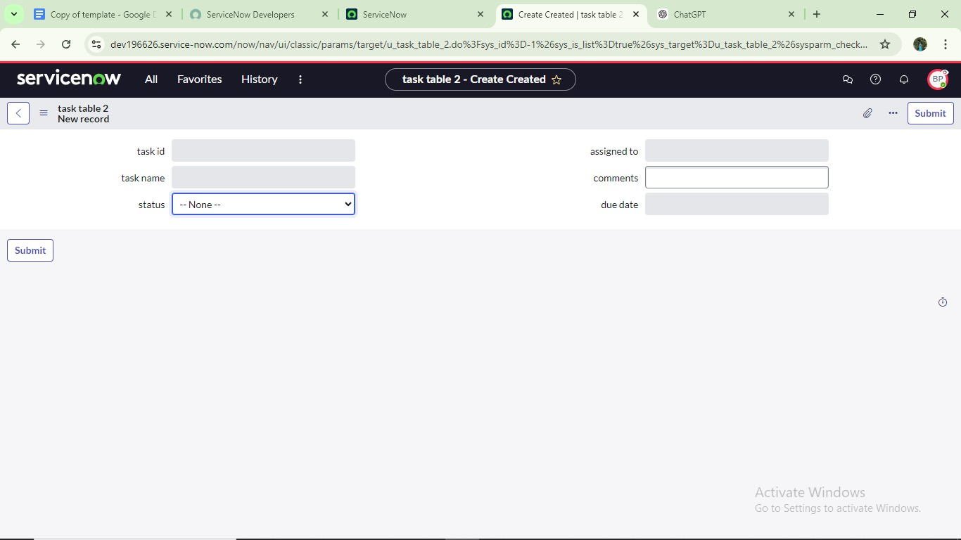
11. Similarly create 4 acl for the following fields
Click on profile on top right side
Click on impersonate user
Select bob user
Go to all and select task table2 in the application menu bar
Comment and status fields are have the edit access

Slide 13
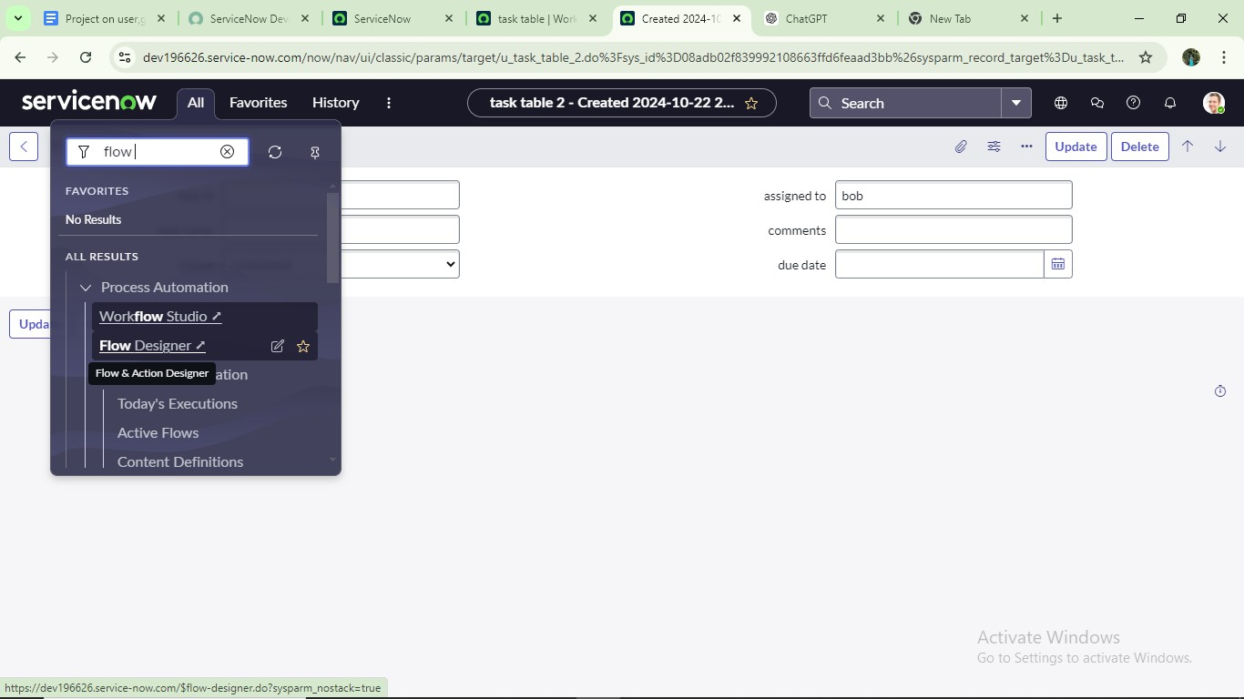
Create a Flow to Assign operations ticket to group :
Open service now.
Click on All >> search for Flow Designer
Click on Flow Designer under Process Automation.
After opening Flow Designer Click on new and select Flow.
Under Flow properties Give Flow Name as “ task table”.
Application should be Global.
Click build flow.

Slide 14


G fie devl96626.service-aw.can-t/now/\zrorkfTow—studio/homp/flow
g Hame a e
M Operations
dP IntegraŁions
Playbooks
Suoflows
Actions
Decision tables
Pick up where you left off
Flows
ast refreshed us I now
BeuchmarkRecommeudatiou Evauaor
Status
¡ęg
Upąatg Subflow
2024-09 °^{A1‹on}
Decision table
0 0-09
Create Flow Data
eenchmarks spoke
crue
Cloud lnfrastructure
fiuthorize
Change Emergency
Global
1ue
•” ' Łast update fi 5 mo nths ago by Sy
Global
Global Global
true
2020 1 4-4 4 07:0B:05
wue
2020 10-06
2O20-09—23 05:06:26
System Administrator modified
tastabte
Implement
1ue
2020-10-27 04:1 B:08
202D-10-06 05:37:05
@ System Administrador modified
Crea te Fiow Data
s months ago
@ g\/stuoiAdłzVmdzatar modified
Change - Emergency - Review
1ue
1ue
1ue
change - Normal - Assess
Global
Change Normal Authorize
2020 40D6
Normal
true
2020-09-23 04:23:59
{- 4 G fie devl96626.service-aw.can-t/now/\zrorkfTow—studio/buiłder?tyqeSysld=2d0Se527439231l06cdbbDl l7lb8f2o8Bsysłd= 1
Let's get the details for your flow
e
Describe your Oaw.
Global
show addicional properties
Ac t ivatc ‘Windows
Go to Sett'

Slide 15
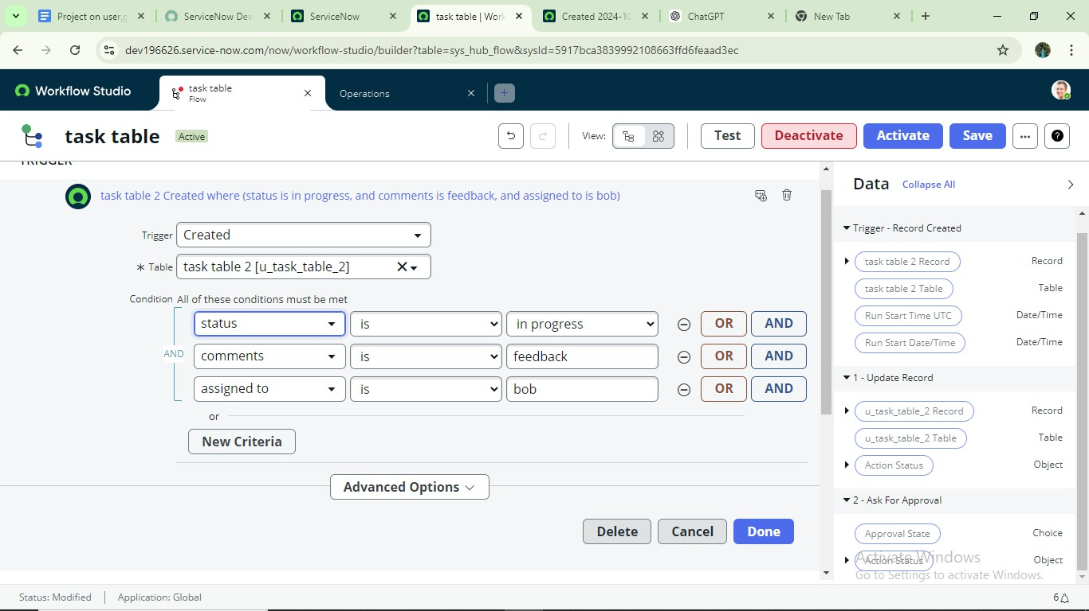
next step:
Click on Add a trigger
Select the trigger in that Search for “create record” and select that.
Give the table name as “ task table ”.
Give the Condition as Field : status Operator :is Value : in progress Field : comments Operator :is Value : feedback
Field : assigned to Operator :is Value : bob
5.
After that click on Done.
Next step:
Click on Add an action.
Select action in that ,search for “ update records”.
In Record field drag the fields from the data navigation from Right Side(Data pill)

Slide 16
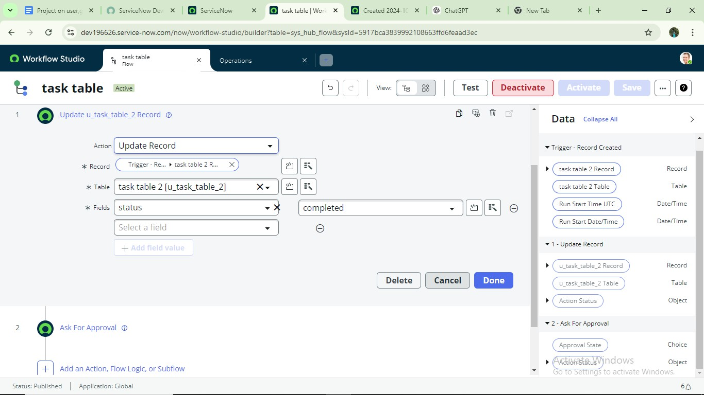
Table will be auto assigned after that
Add fields as “status” and value as “completed”
Click on Done.
Next step:
Now under Actions.
Click on Add an action.
Select action in that ,search for “ ask for approval ”.
In Record field drag the fields from the data navigation from Right side
Table will be auto assigned after that
Give the approve field as “ status”
Give approver as alice p
Click on Done.

Slide 17
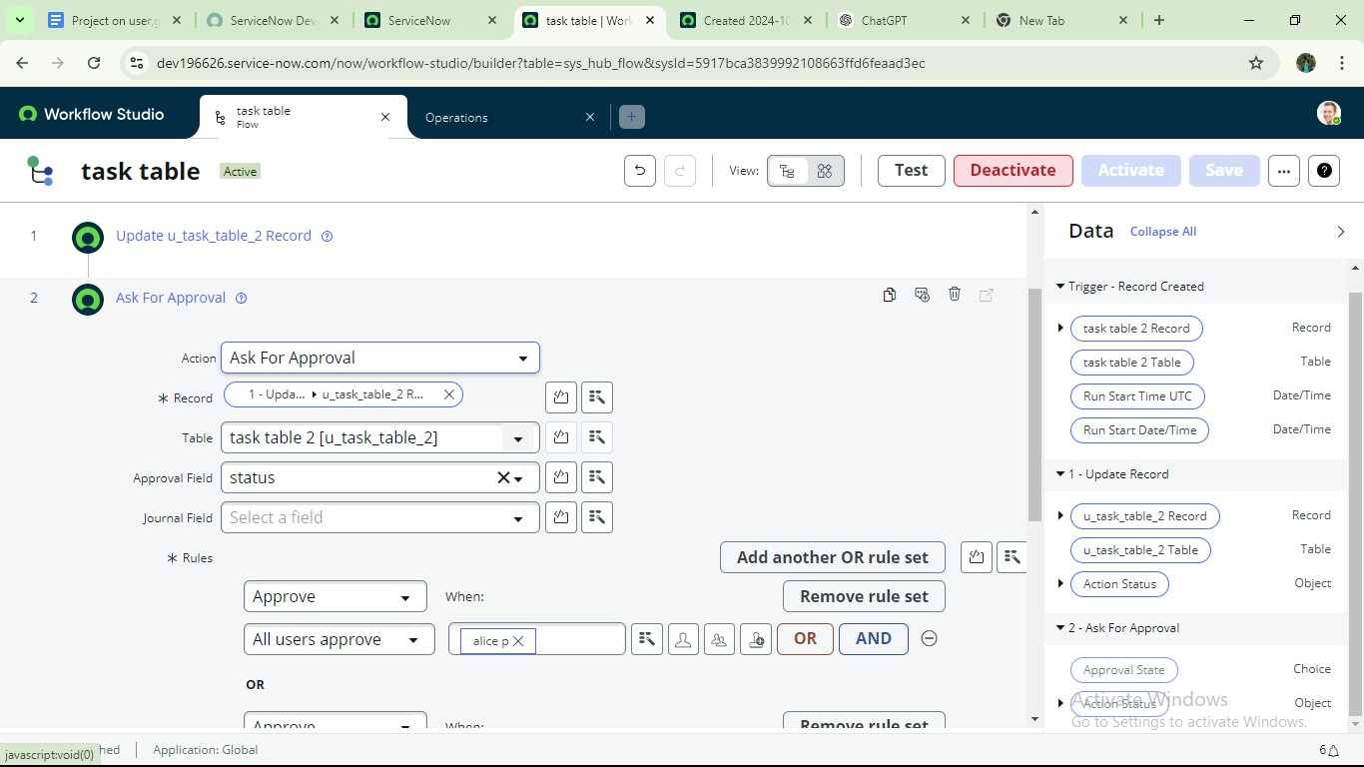
Go to application navigator search for task table.
It status field is updated to completed

Slide 18
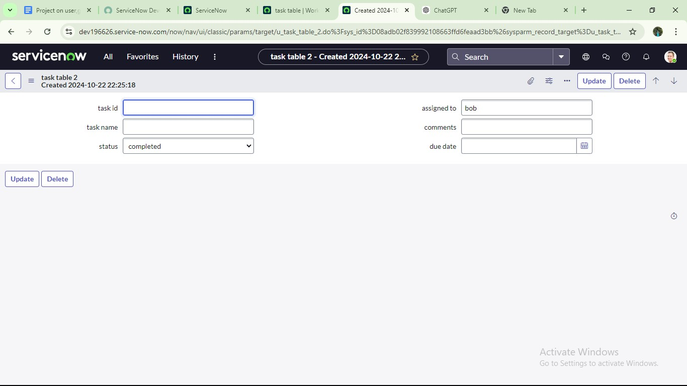
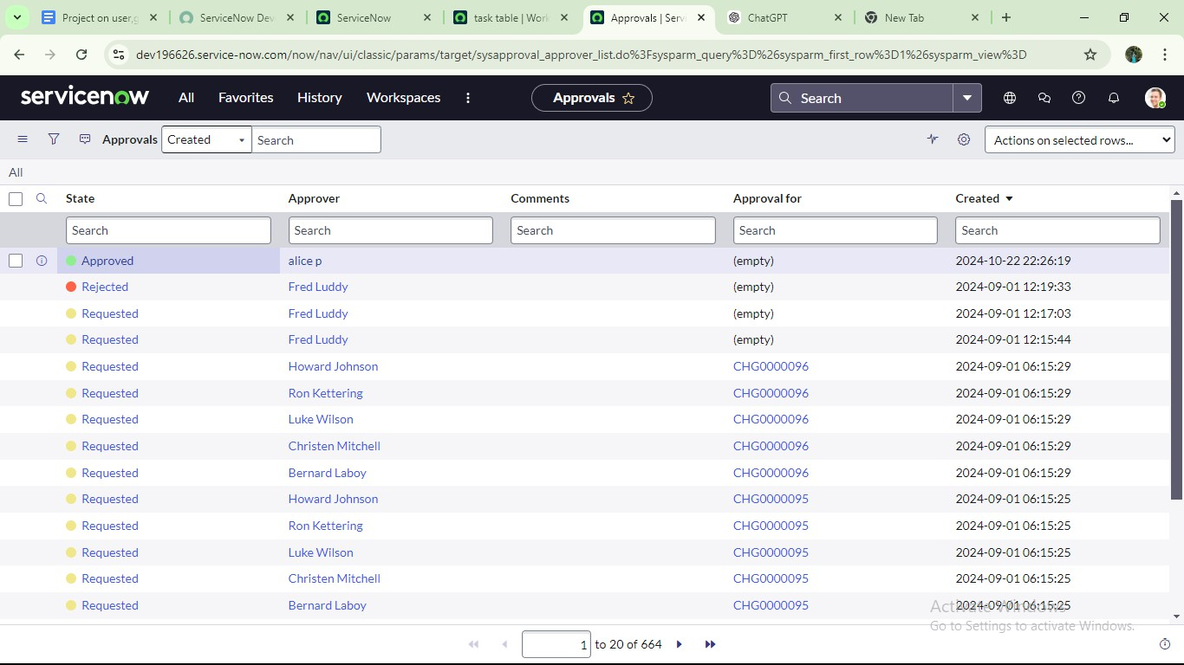
Go to application navigator and search for my approval
Click on my approval under the service desk.
Alice p got approval request then right click on requested then select approved

Slide 19
Conclusion :
This scenario highlights a structured approach to project management, showcasing the roles of Alice and Bob within a defined workflow. With Alice's oversight and Bob's execution, the team effectively collaborates to ensure project success. The use of tables organizes key information, facilitating easy tracking of projects, tasks, and progress updates. Overall, this system promotes accountability, enhances communication, and leads to the successful completion of projects.

